Slide 1

Modules in Python

Slide 2
Modules

Slide 3
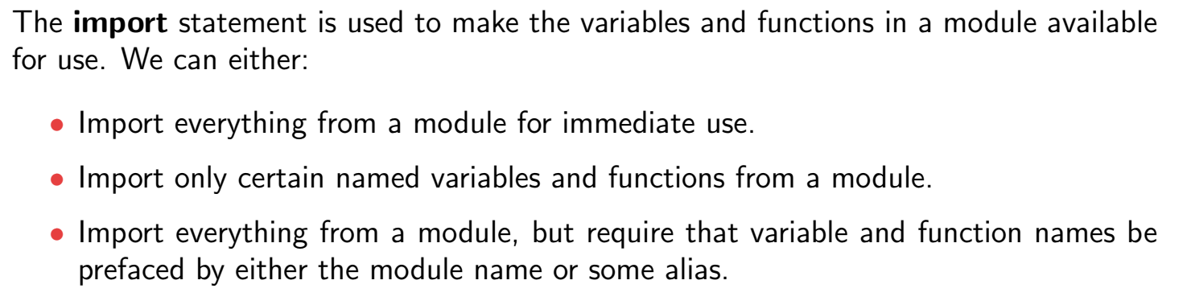
Import statement

Slide 4
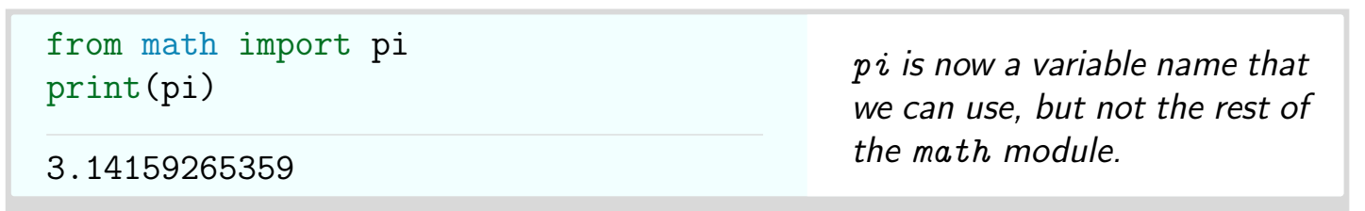
Example

Slide 5
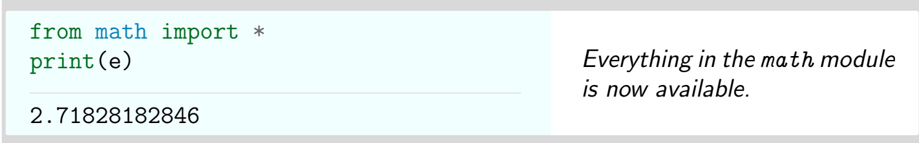
Example

Slide 6
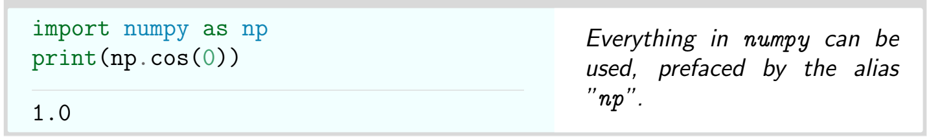
Example

Slide 7
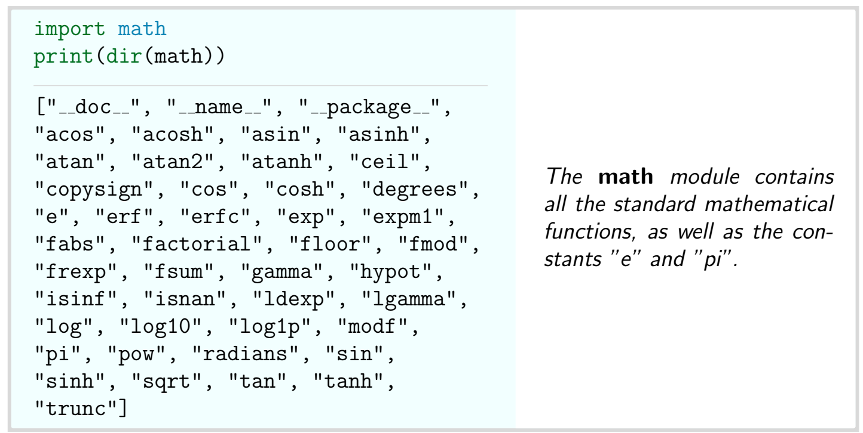
Dir function

Slide 8
Thank You

